Slide 1
Question 1
What is a variable in C/C++?
Answer:
A variable is a named memory location used to store data that can change during program execution.

Slide 2
Question 2
Why do we use variables in programs?
Answer:
Variables are used to store and manage data so that it can be processed and modified in a program.

Slide 3
Question 3
What is the difference between a variable name and its value?
Answer:
A variable name is the identifier of the variable, while the value is the data stored in that variable.

Slide 4
Question 4
Which of the following is a valid variable name? a) 2num b) total_marks c) for d) my marks
Answer:
Answer: total_marks

Slide 5
Question 5
Why is Age different from age?
Answer:
C++ is case-sensitive, so Age and age are treated as two different variables.

Slide 6
Question 6
Can a variable name contain spaces? Why?
Answer:
No, variable names cannot contain spaces because spaces are used to separate words and commands.

Slide 7
Question 7
Can a variable name start with an underscore (_) ?
Answer:
Yes, a variable name can start with an underscore.

Slide 8
Question 8
What happens if two variables have the same name in the same scope?
Answer:
The compiler generates an error because variable names must be unique within the same scope.

Slide 9
Question 9
Write three meaningful variable names for storing student information.
Answer:
studentName
rollNumber
studentMarks

Slide 10
Question 10
Which naming convention is better and why: studentMarks or sm?
Answer:
studentMarks is better because it is meaningful and easier to understand.

Slide 11
Question 11
What is a data type?
Answer:
A data type specifies the type of data that a variable can store.

Slide 12
Question 12
Which data type is used to store whole numbers?
Answer:
Answer: int

Slide 13
Question 13
Which data type is used to store decimal values?
Answer:
Answer: float or double

Slide 14
Question 14
What is the difference between float and double?
Answer:
double provides greater precision and can store larger decimal values than float.

Slide 15
Question 15
Which data type stores a single character?
Answer:
Answer: char

Slide 16
Question 16
Which data type stores True/False values?
Answer:
Answer: bool

Slide 17
Question 17
What data type is suitable for storing a person's name?
Answer:
Answer: string

Slide 18
Question 18
Predict the output: int age=18; cout<<age;
Answer:
Output: 18

Slide 19
Question 19
Identify the data type: 25, 3.14, 'A', true.
Answer:
25 → int
3.14 → float/double
'A' → char
true → bool

Slide 20
Question 20
What happens if you store a decimal number in an int variable?
Answer:
The decimal part is removed, and only the integer part is stored.

Slide 21
Question 21
What is the purpose of cin?
Answer:
cin is used to take input from the user.

Slide 22
Question 22
What is the purpose of cout?
Answer:
cout is used to display output on the screen.

Slide 23
Question 23
Which symbol is used with cin?
Answer:
Answer: >>

Slide 24
Question 24
Which symbol is used with cout?
Answer:
Answer: <<

Slide 25
Question 25
Explain: cin >> age;
Answer:
This statement takes input from the user and stores the entered value in the variable age.

Slide 26
Question 26
Explain: cout << age;
Answer:
This statement displays the current value stored in the variable age on the screen.

Slide 27
Question 27
What is the purpose of endl?
Answer:
endl inserts a new line and moves the cursor to the beginning of the next line.

Slide 28
Question 28
Write a statement to input a student's marks.
Answer:
The statement is: cin >> marks; It accepts marks entered by the user and stores them.

Slide 29
Question 29
Write a statement to display 'Welcome to C++'.
Answer:
The statement is: cout << "Welcome to C++"; It displays the given message on the screen.

Slide 30
Question 30
Predict the output: cout << 'Programming';
Answer:
The output will be Programming because cout displays the text provided within the output statement.

Slide 31
Question 31
What is an operator?
Answer:
An operator is a symbol that performs mathematical, relational, logical, or other operations on variables and values.

Slide 32
Question 32
Which operator is used for addition?
Answer:
The plus sign (+) is used as the addition operator to add two or more values.

Slide 33
Question 33
What is the result of 10 % 3?
Answer:
The result is 1 because 10 divided by 3 leaves a remainder of 1.

Slide 34
Question 34
What is the result of 8 % 2?
Answer:
The result is 0 because 8 is completely divisible by 2 with no remainder.

Slide 35
Question 35
Which operator checks equality?
Answer:
The equality operator (==) is used to check whether two values are equal or not.

Slide 36
Question 36
What is the difference between = and == ?
Answer:
The = operator assigns a value to a variable, while == compares two values for equality.

Slide 37
Question 37
What is the result of 5 > 3?
Answer:
The result is true because 5 is greater than 3, making the comparison correct.

Slide 38
Question 38
What does && represent?
Answer:
&& represents the logical AND operator. It returns true only when both conditions are true.

Slide 39
Question 39
What does || represent?
Answer:
|| represents the logical OR operator. It returns true if at least one condition is true.

Slide 40
Question 40
What does ! represent?
Answer:
! represents the logical NOT operator. It reverses the logical value of a condition.

Slide 41
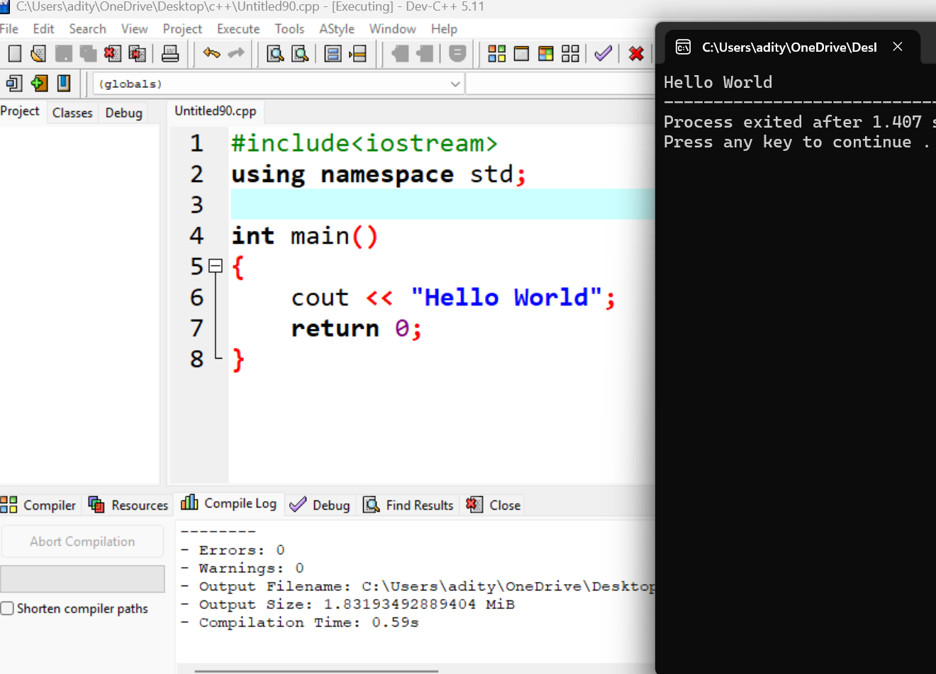
Question 41
Write a program to print 'Hello World'.

Slide 42
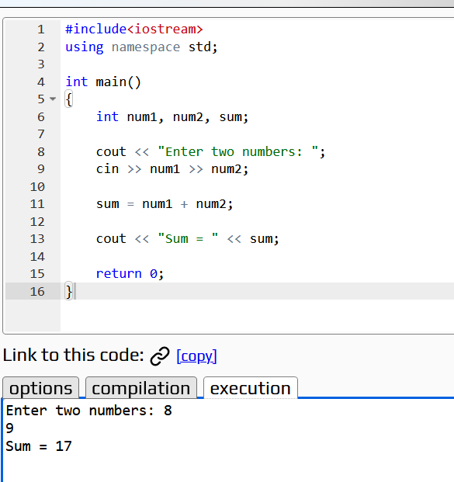
Question 42
Write a program to input two numbers and display their sum.

Slide 43
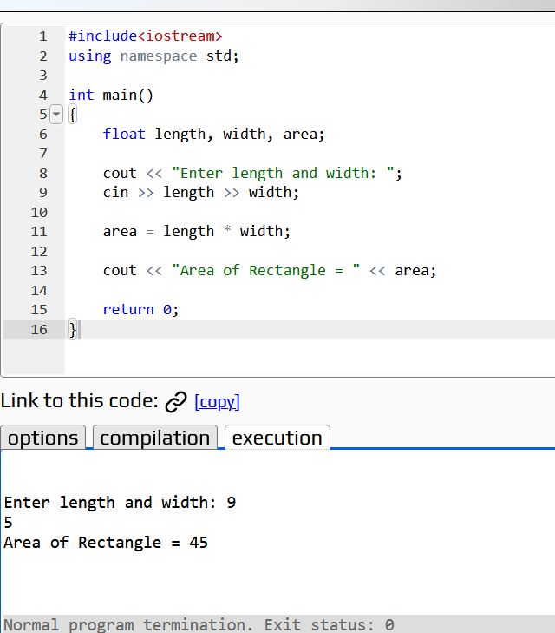
Question 43
Write a program to calculate the area of a rectangle.

Slide 44
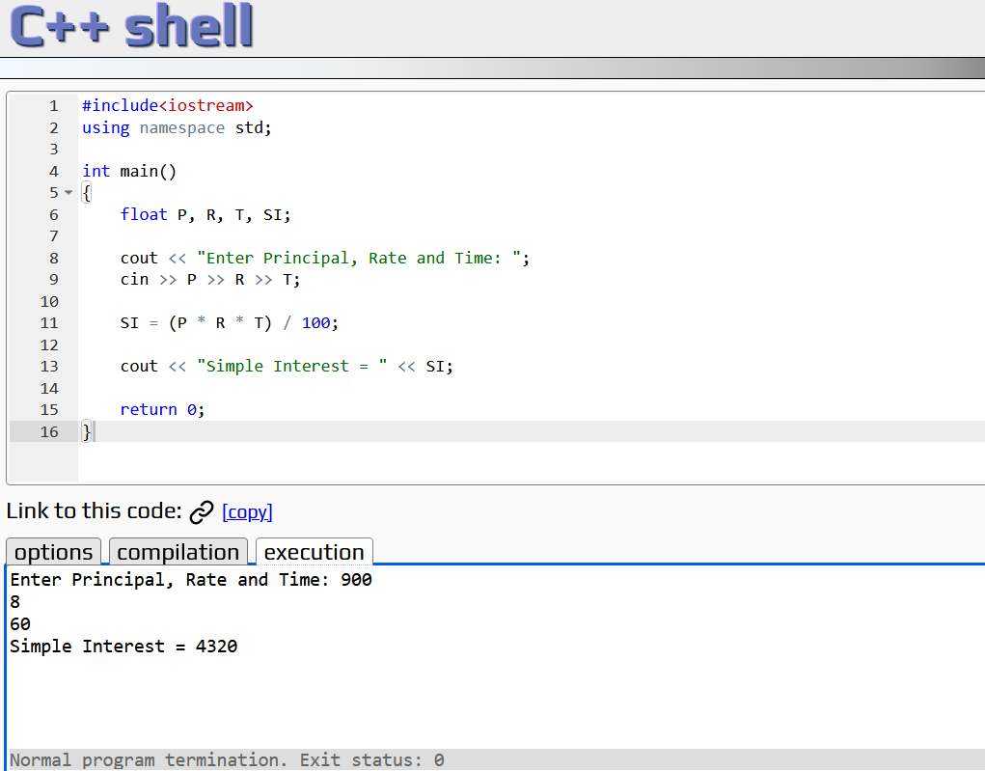
Question 44
What formula is used to calculate Simple Interest?
SI=(P*R*T)/100
Where P=Principal Value
R=Rate
T=Time

Slide 45
Question 45
Write a program to calculate Simple Interest.

Slide 46
Question 46
Why is a temporary variable used while swapping two numbers?
Answer:
A temporary variable is used to store one value temporarily during swapping. This prevents the original value from being lost before the exchange is completed.

Slide 47
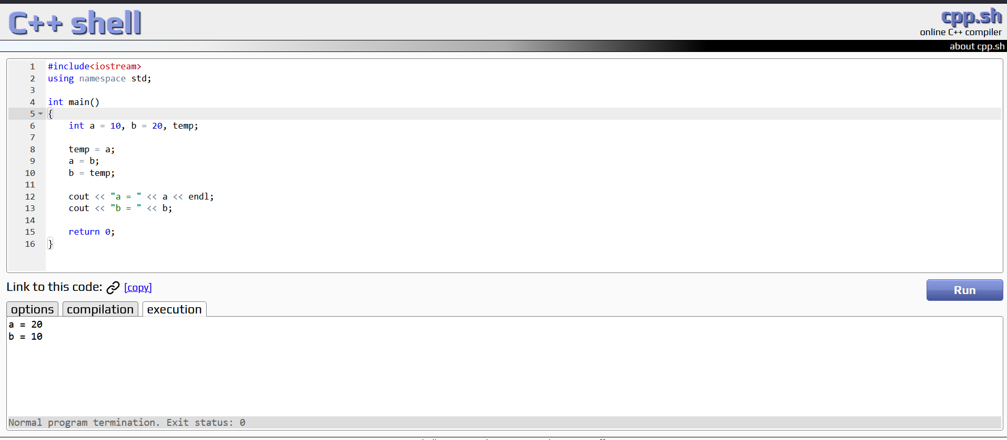
Question 47
Swap the values: a=10, b=20.

Slide 48
Question 48
What formula is used to convert Celsius into Fahrenheit?
F=(9/5*C)+32
Where, F=Fahrenheit
C=Celcius

Slide 49
Question 49
What is the Fahrenheit value of 0°C?
32 degree F

Slide 50
Question 50
Why can integer division give incorrect results in the Celsius-to-Fahrenheit program?
Answer:
Integer division removes the decimal part of a result. For example, 9/5 = 1 instead of 1.8, which can make the Fahrenheit calculation inaccurate.

